Slide 1

HOUSING PRICE PREDICTION
SUBMITTED BY : ABHIJEET Singh MENTOR NAME: Mr. Prateek Vashishtha
SHIVANGI GARG
AISHWARYA CHAUHAN
AASMA Siddiqui

Slide 2
OUTLINE
Introduction
Project Summary
Technology used
Tools used
How it works ?

Slide 3
INTRODUCTION
Why house price prediction?
Prediction house prices are expected to help people who plan to buy a house so they can know the price range in the future, then they can plan their finance well.
House price predictions are also beneficial for property investors to know the trend of housing prices in a certain location.
Generally, Buying a house can be a tough task but knowing the house prices can help buyers to fill the information gap and improve real estate efficiency.

Slide 4
PROJECT SUMMARY
Housing Price Prediction is a Machine learning project and based on linear regression algorithm.
Predicting house prices can help to determine the selling price of a house of a particular region and can help people to find the right time to buy a home.
By analyzing historical data for house prices along with various relevant features, we established some interesting patterns and trends. Using machine learning techniques, we were then able to identify a subset of the original features that are in a sense sufficient to describe our data.
This model can therefore be used to predict, for example, which type of house is likely to increase and decrease in price based on various scenarios.

Slide 5
TECHNOLOGIES USED
Machine learning
Machine Learning is a method of data analysis that automates analytical model building.
Machine learning is a branch of artificial intelligence (AI) and computer science which focuses on the use of data and algorithms to imitate the way that humans learn, gradually improving its accuracy.
It works on the idea that systems can learn from data, identify patterns and make decisions with minimal human intervention. The goal of machine learning technology is to optimize the performance of a system when handling new instances of data through user defined programming logic for a given environment.

Slide 6
Machine learning tasks are usually split into three categories: supervised, unsupervised and reinforcement.
For this competition, our task is supervised learning.
Supervised learning uses examples and labels to find patterns in data.

Slide 7
Linear Regression
Linear Regression is a machine learning algorithm based on supervised learning. It performs a regression task. Regression models a target prediction value based on independent variables.
It is mostly used for finding out the relationship between variables and forecasting. Different regression models differ based on – the kind of relationship between dependent and independent variables, they are considering and the number of independent variables being used.
Linear regression performs the task to predict a dependent variable value (y) based on a given independent variable (x). So, this regression technique finds out a linear relationship between x (input) and y(output). Hence, the name is Linear Regression.

Slide 8
TOOLS USED
We have used Python and Jupyter notebooks in our project.
PYTHON: Python is a computer programming language often used to build websites and software, automate tasks, and conduct data analysis. Python is a general purpose language, meaning it can be used to create a variety of different programs and isn't specialized for any specific problems.
JUPYTER: The Jupyter Notebook is an open-source web application that allows data scientists to create and share documents that integrate live code, equations, computational output, visualizations, and other multimedia resources, along with explanatory text in a single document.

Slide 9
LIBRARIES USED
Libraries: These are frameworks in python to handle commonly required tasks.
Pandas — For handling structured data
Matplotlib — For plotting libraries for python
NumPy — For linear algebra and mathematics
Seaborn — For data visualization

Slide 10
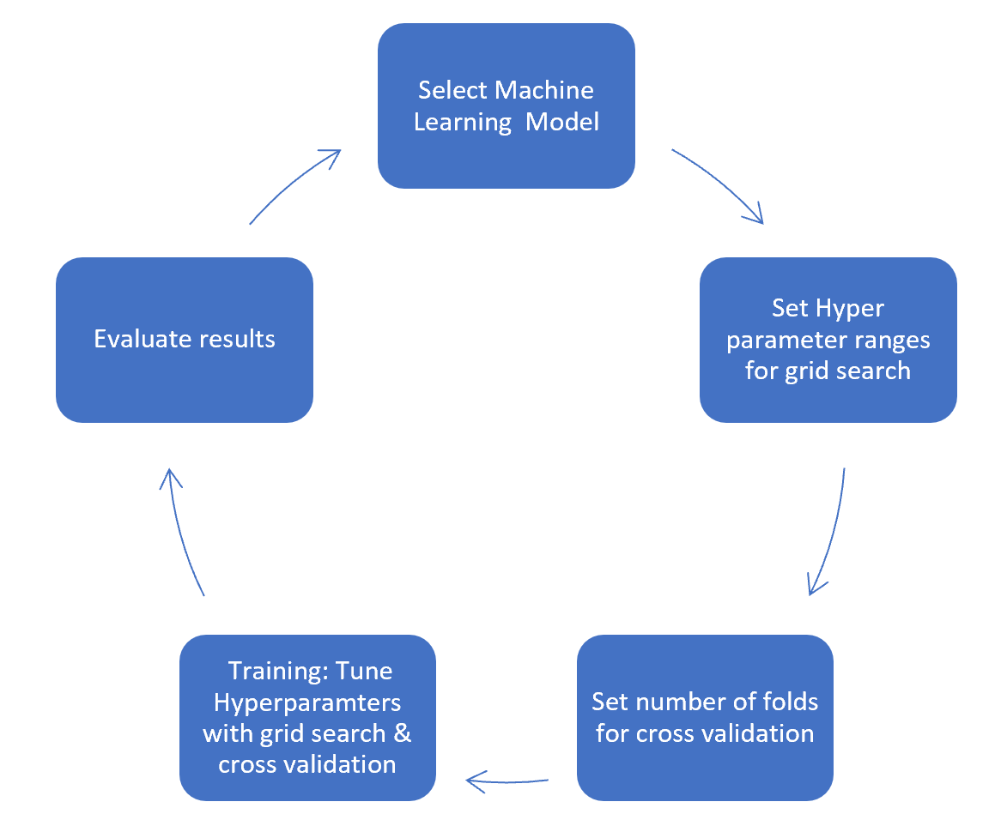
HOW IT WORKS ?
COLLECTING DATA: The very first step is to collect the data. We collect data from various resources and merge it together to form our training data set.
TRAINING MODEL: Second step is to train the model using machine learning algorithm which is MULTIPLE LINEAR REGRESSION in this case.
PREDICTION: Based on the generated graphs we can predict the cost of the house.

Slide 11
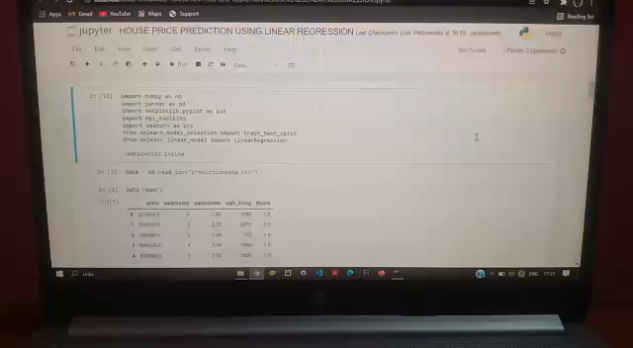
Implementation of our Project

Slide 12
Questions?

Slide 13
THANK YOU

